Slide 1
Pathways Overview
District 5

Slide 2
Content
Overview of Pathways Learning Experience
How to Select Your Path
How to Start Your First Project
How to Complete a Project
How to Complete a Level

Slide 3
What is Pathways?

Slide 4
Pathways is Designed for:
Real World Needs |  | Communication Leadership Mentoring
Real World Communications |  | Speaking Presenting Webinars Podcasts Blogging, etc.
Real World Applications |  | Workplace Community Home

Slide 5
Rich Content
Tutorials
Videos
Interactive lessons
Worksheets
Checklists
Project Manual PDFs
Evaluations Forms

Slide 6
Personalized Learning
You Choose:
How you learn - Print or Online
What you learn
Your Path ( e.g. Dynamic Leadership vs Presentation Mastery)
Elective Projects – to meet your desired specialization
How fast you learn – Self-paced
Where you apply – Work, Community, Club

Slide 7
Pathways Curriculum Structure
Pathways Structure
University Analogy
Paths
Levels
Projects
‘Major’ (Finance vs Engineering, etc)
‘Years of school’ (Freshman- Grad School)
‘Courses’

Slide 8
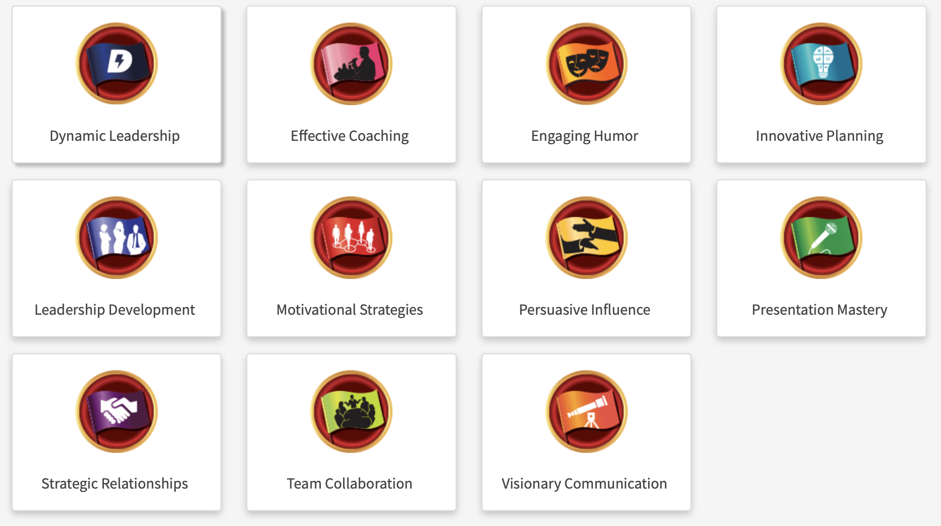
11 Paths to meet your personal goals
+

Slide 9
5 Levels per Path
LEVEL 1 | LEVEL 2 | LEVEL 3 | LEVEL 4 | LEVEL 5
Mastering Fundamentals | Learning Your Style | Increasing Knowledge | Building Skills | Demonstrating Expertise
~ ’Freshman’
~ ’Sophomore’
~ ‘Junior’
~ ’Senior’
~’ Graduate’
With Progression Through Levels 1-5:
Knowledge & expertise increases
Option to specialize skills increases

Slide 10
Over 60 Projects To Select To Meet Your GOals
Connect with Your Audience Effective Body Language Develop a Communication Plan Persuasive Speaking Present a Proposal Reaching Consensus Successful Collaboration Conflict Resolution Make Connections Through Networking | Connect with Storytelling Creating Effective Visual Aids Deliver Social Speeches Inspire Your Audience Understand Vocal Variety Managing a Difficult Audience Communicate Change Improvement Through Positive Coaching Leading in Difficult Situations Manage Projects Successfully | Public Relations Strategies Write a compelling Blog Mentoring Develop Your Vision Manage Successful Events Lead Your Volunteer Organization Prepare to Speak Professionally Ethical Leadership Moderate a Panel Discussion

Slide 11
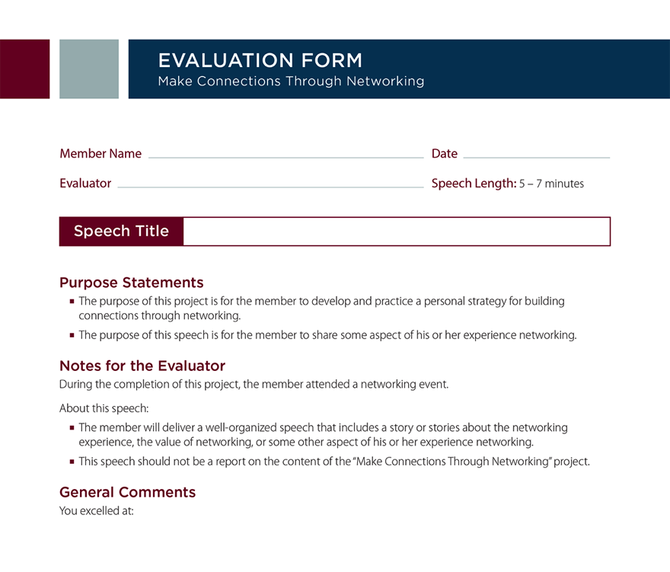
Evaluations

Slide 12
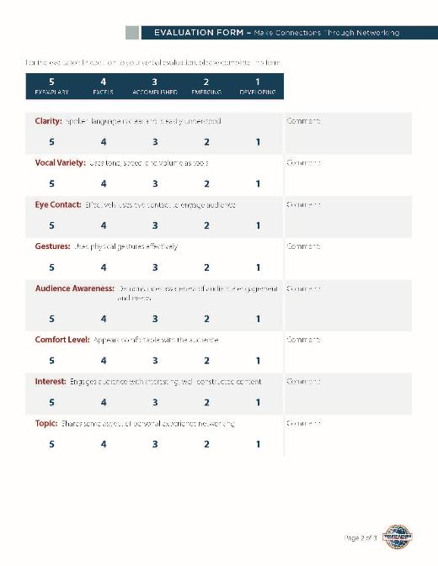

Slide 13
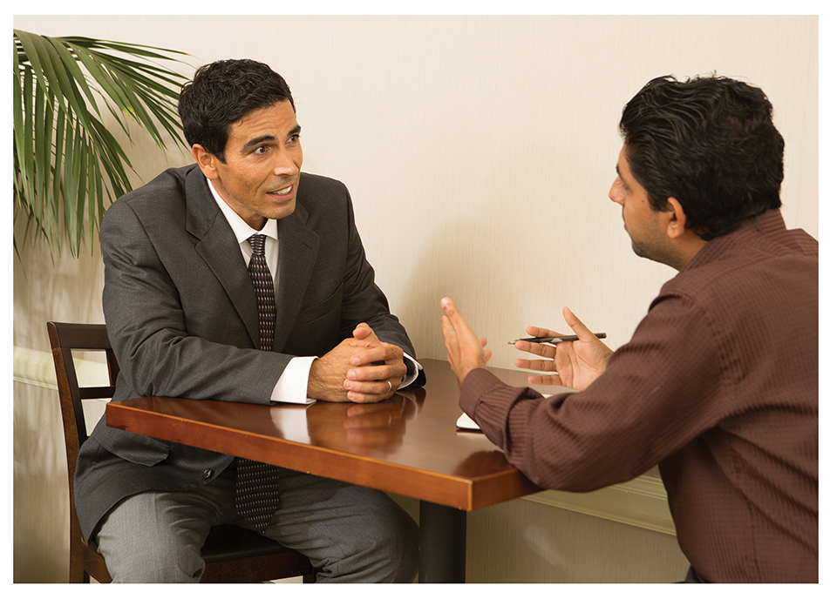
Pathways Mentor Program

Slide 14
Log in, Take Assessment, Select Your Path

Slide 15
Log in To Toastmasters.org

Slide 16
Select “Pathways”, then “Choose A Path”

Slide 17
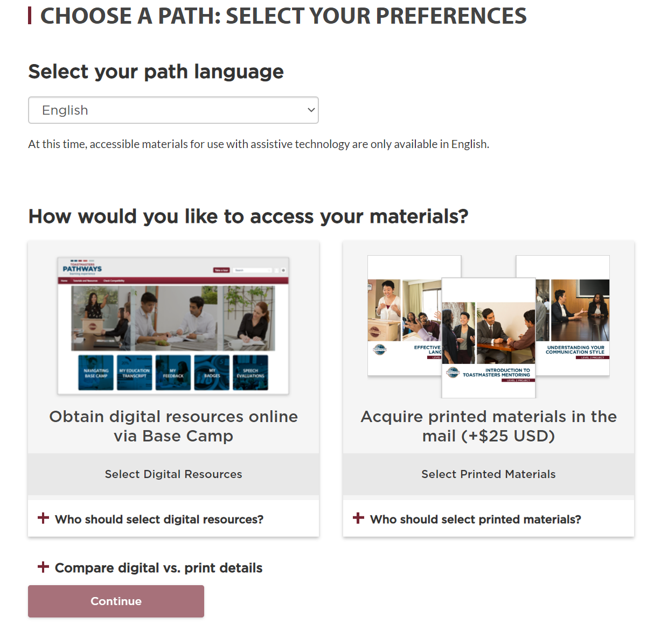
Choose Base Camp* (Online) or Print option
* Base Camp is the Online Gateway to Pathways. Analogy is “An Online Campus”

Slide 18
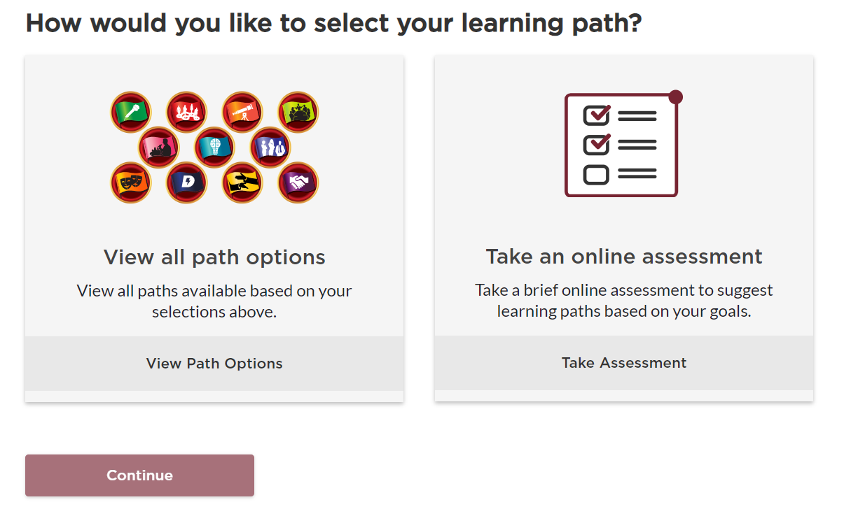
Start Your Pathways Assessment

Slide 19
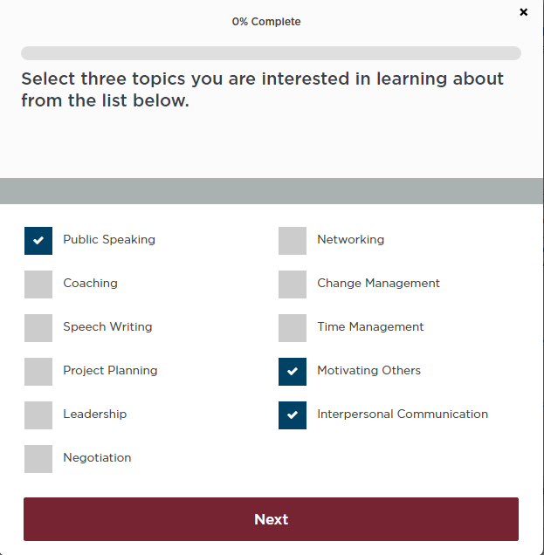
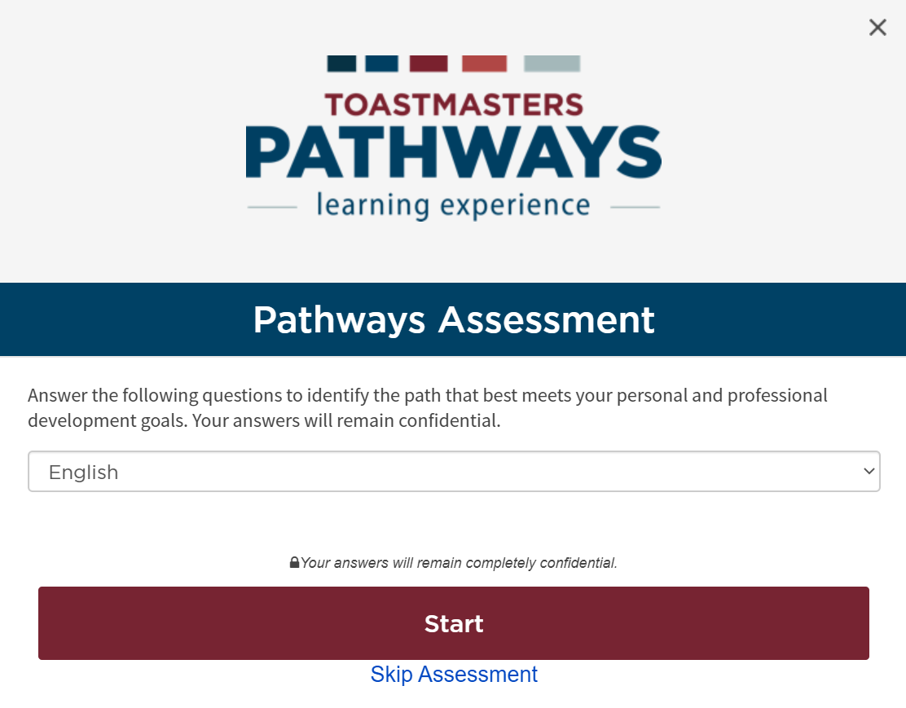
Answer A Series of Questions

Slide 20
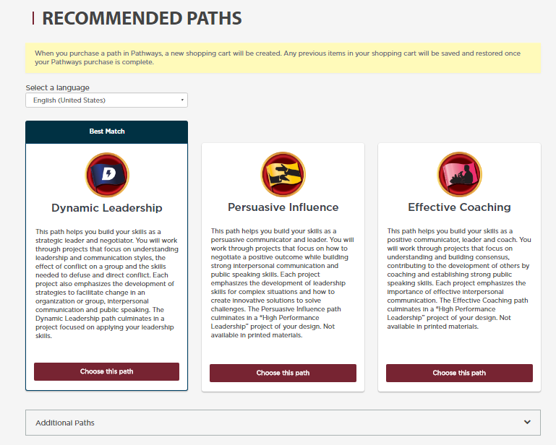
Select a Recommended Path or view Additional
C
C

Slide 21
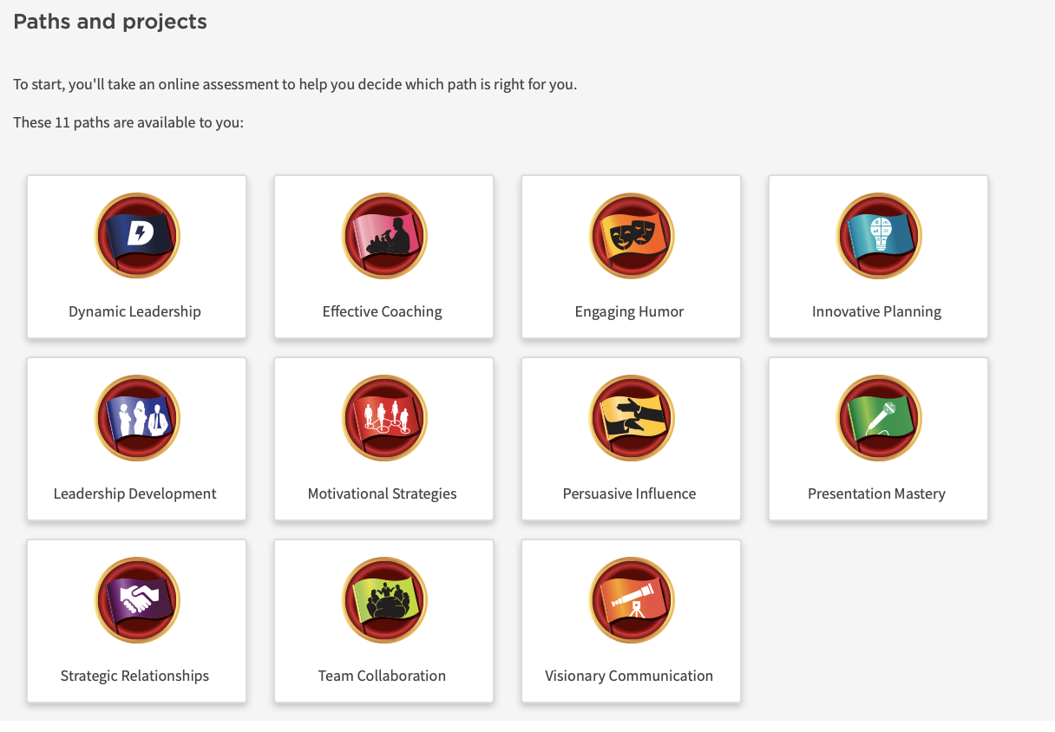
For a Closer Look at the Paths
Select Pathways from Toastmasters home page
Select “Learn More”
Scroll Down to “Paths & Projects”
Select a Path
C

Slide 22
See A Path, All 5 Levels, Projects Per Level

Slide 23
Get Started With First Project

Slide 24
Log In
Log –In to Toastmasters.org
Select ‘Pathways’; ‘Go To Base Camp’

Slide 25
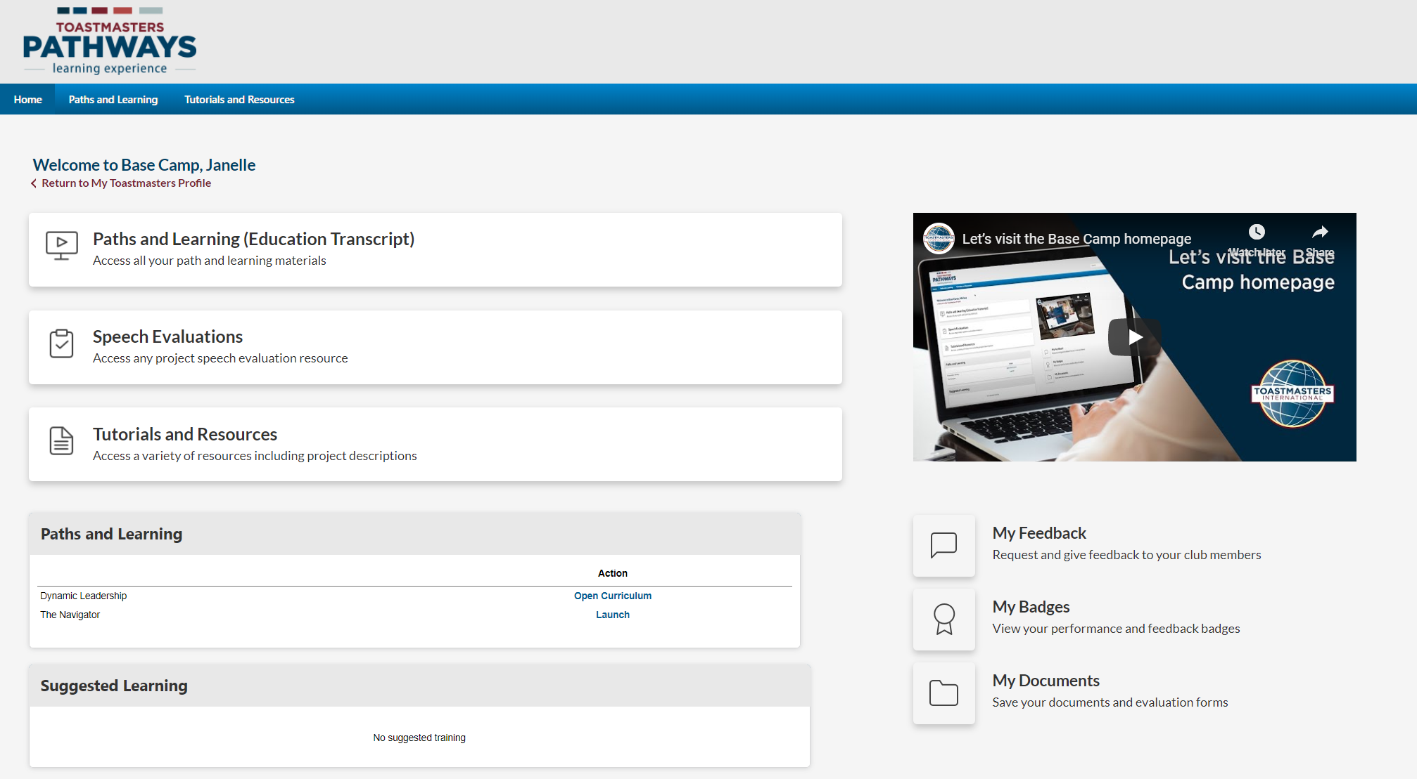
Base Camp: HOME PAGE

Slide 26
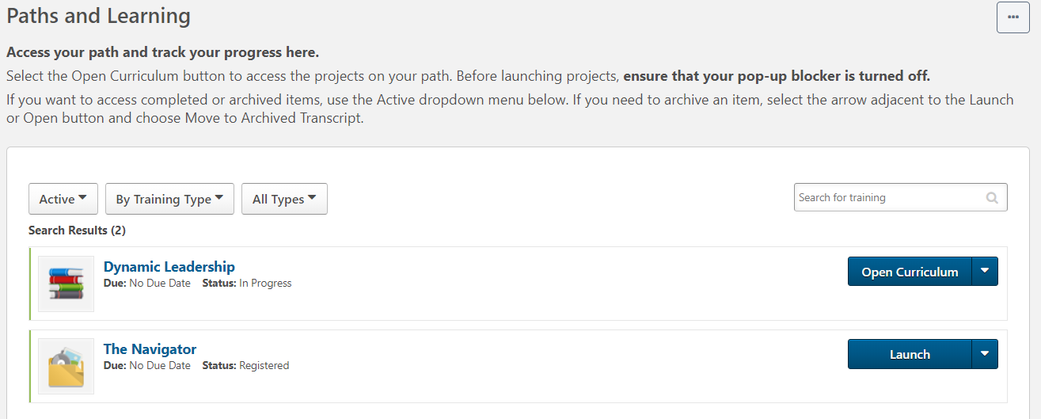
Base CamP: Paths & Learning

Slide 27
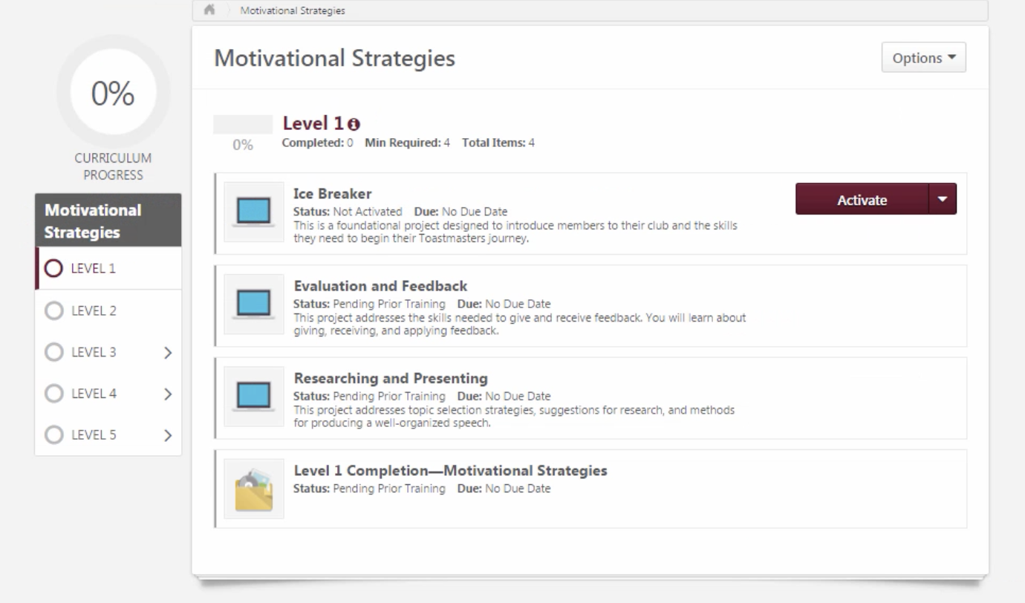
BASE CAMP: activate level 1
Select “Activate”
Select “Launch”

Slide 28
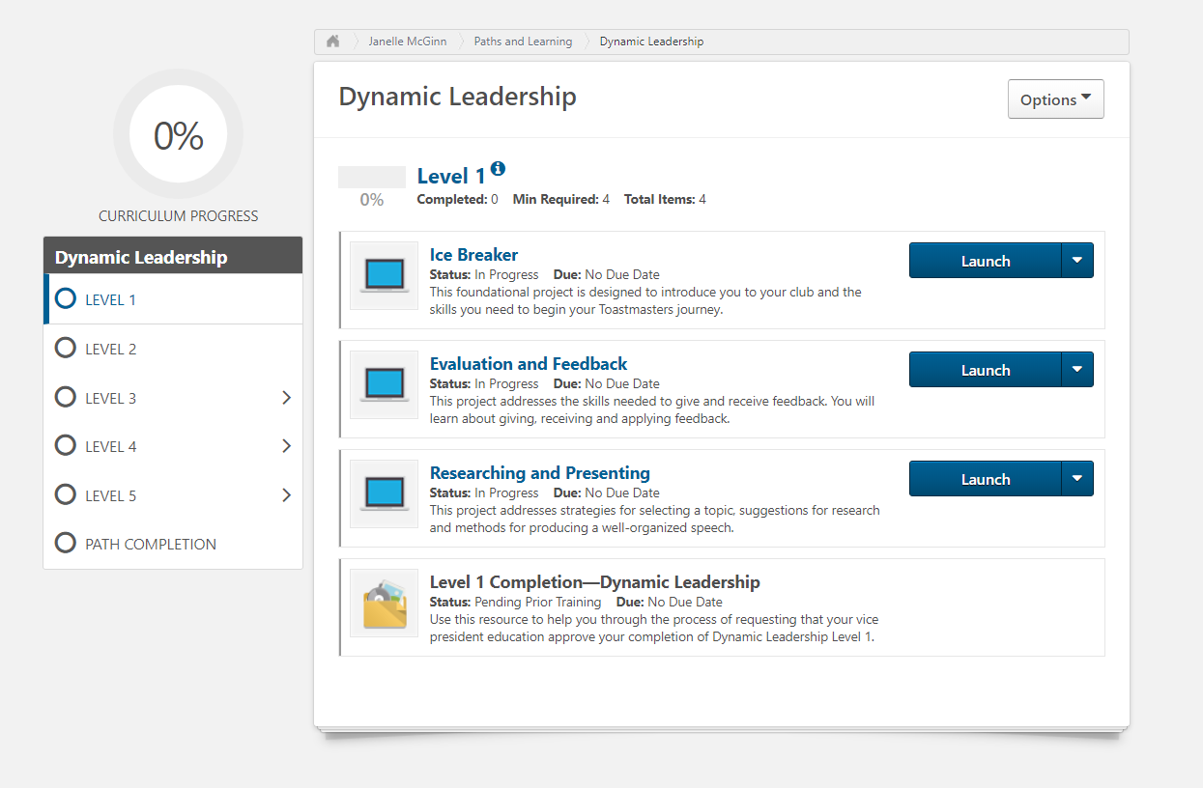
BASE CAMP: launch ice breaker
Select “Launch”

Slide 29
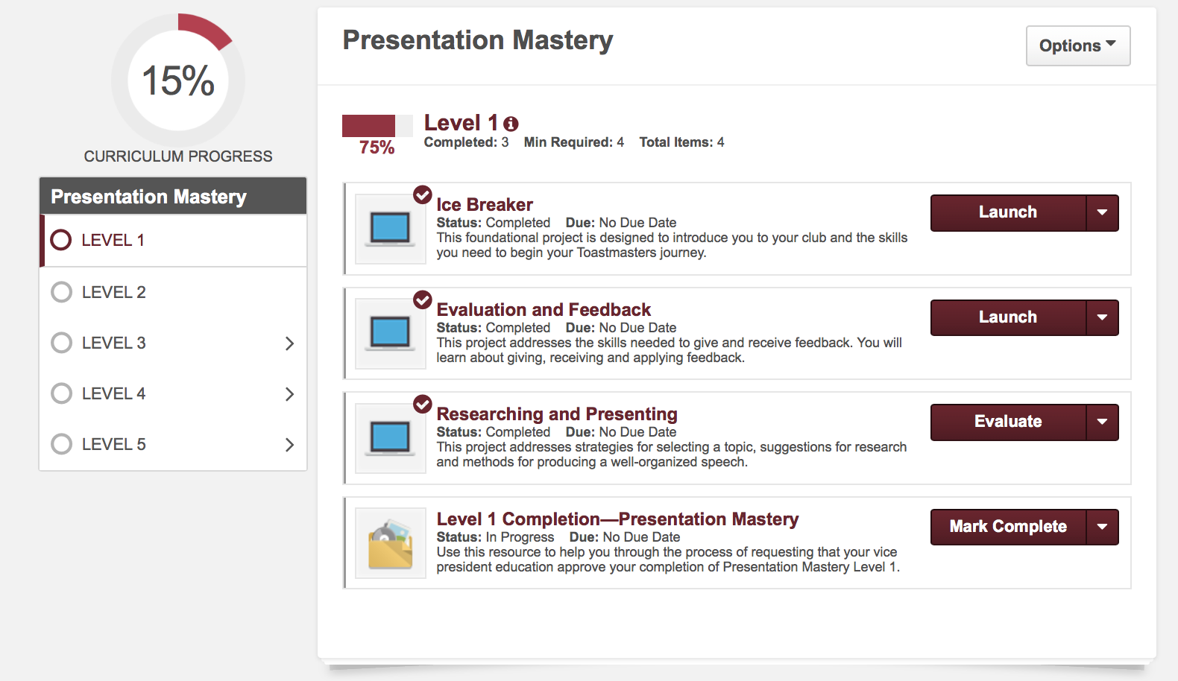
BASE CAMP: Curriculum status
MY PATH
Projects
In
Level 1
LEVELS

Slide 30
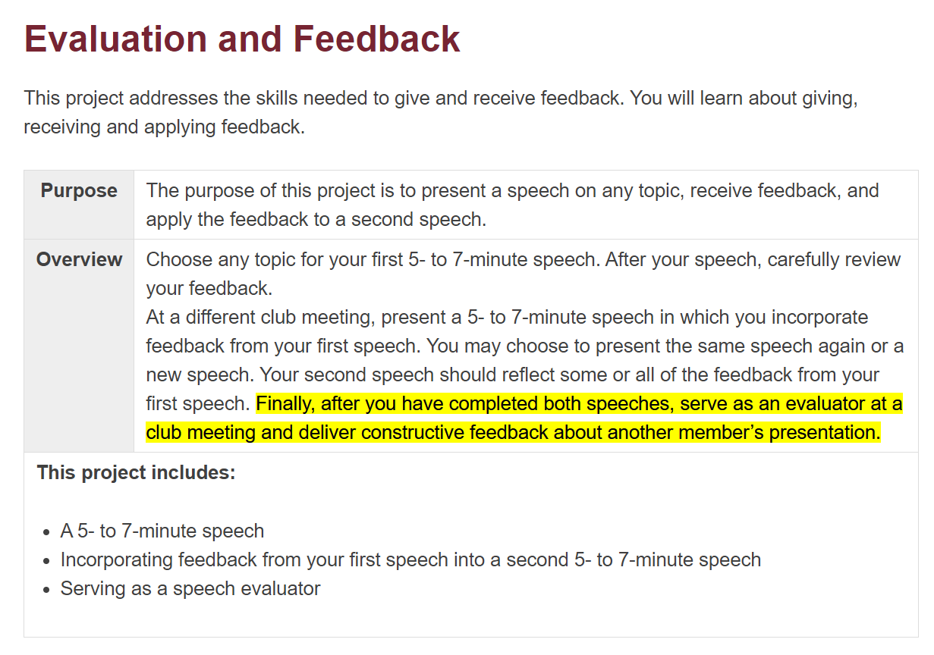
BASE CAMP: evaluation & feedback

Slide 31
TIP: Maximize screen to Navigate Project (arrows)

Slide 32
Work Through & Complete Your Project
Navigate through the project and complete speeches, roles, and skill assessments

Slide 33
Key Points

Slide 34
Complete Your Project: “Assess Your Skills” – After
Answer questions at START of each Project
Answer questions at END of each Project
A MUST DO to Complete a Project!

Slide 35
Complete a level
Select ”Mark Complete”
An email is sent to Base Camp Manager (BCM)
BCM MUST approve before you can move to next level.

Slide 36
Questions?

Slide 37
https://www.toastmasters.org/

